Slide 1
Observations for assessing models’ representation of Nordic Seas’ overflows
M. Almansi, D. Bruciaferri, C. Guiavarc’h, H. Hewitt

Slide 2
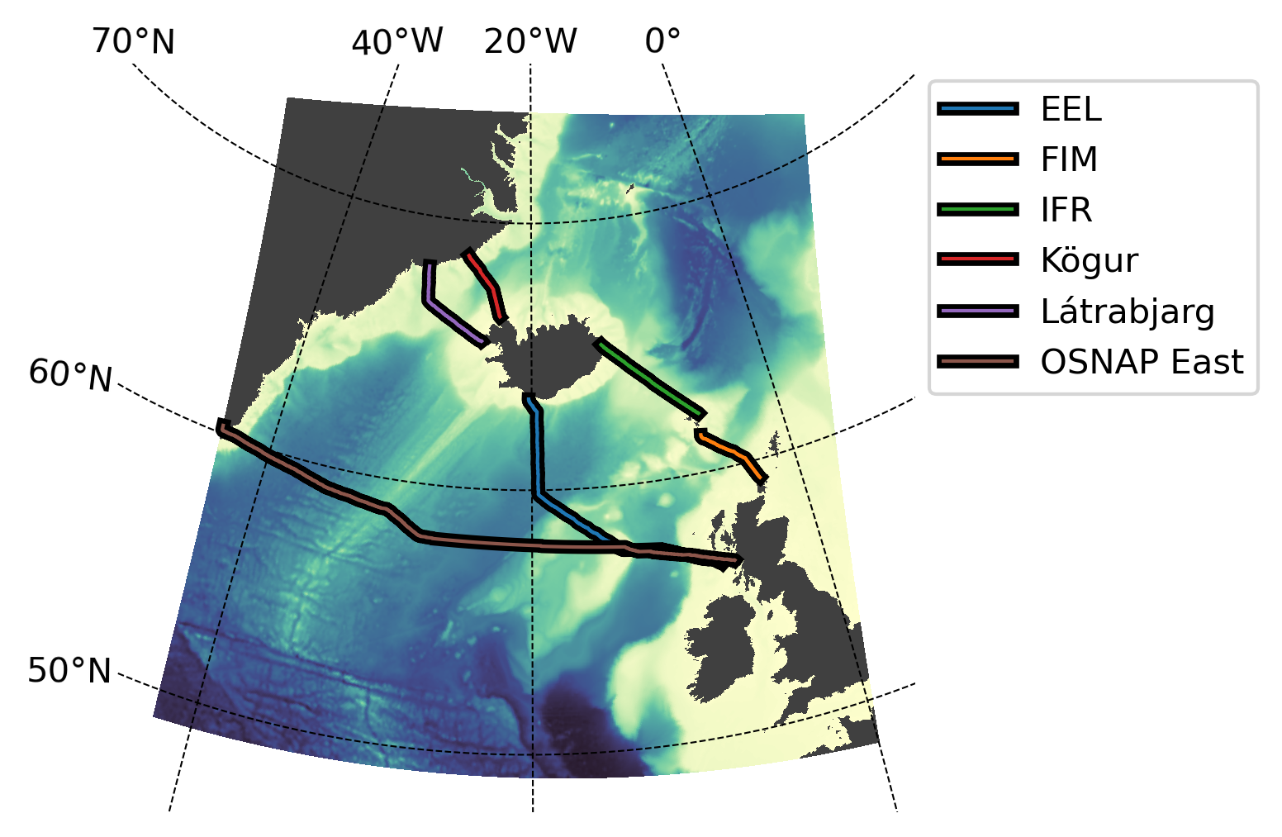
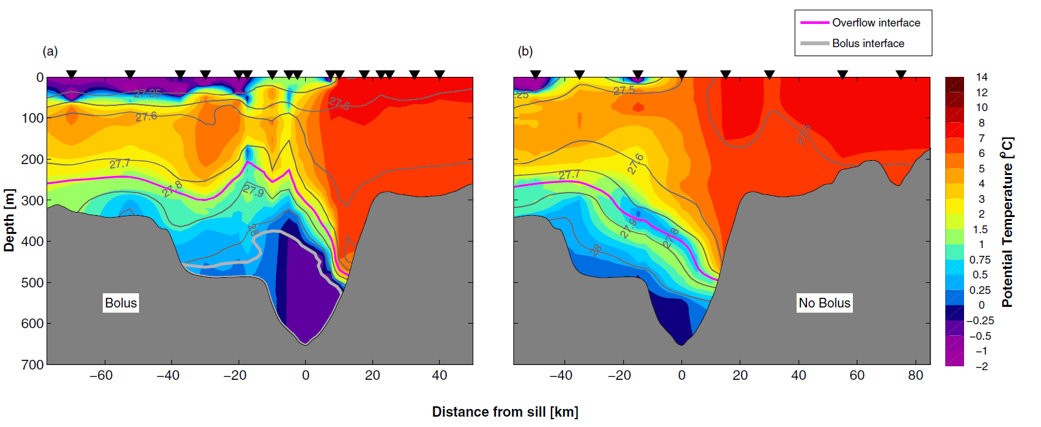
What Mattia already has
Format: MAT files
CTD data from 111 shipboard transects occupied in the vicinity of the Denmark Strait sill between Mar. 1990 and Aug. 2012 are used to generate MEAN potential temperature and salinity sections across the Latrabjarg line for the period 1990-2012
From https://agupubs.onlinelibrary.wiley.com/doi/full/10.1002/2016JC012007

Slide 3
What Mattia already has
High resolution mooring gridded data of water column hydrography and velocity from Sep. 2011 to Aug. 2012.
Format: MAT file

Slide 4
What Mattia already has
Format: netCDF
Two netCDF files including data for the period 31-Jul-2014 to 20-Apr-2016 :
MOC, MHT and MFT time series with uncertainty estimates: the file “OSNAP_Transports_201408_201604_2018.nc” contains 30-day mean estimates of the
MOC and its associated heat and freshwater transports
Gridded temperature and salinity fields: The file “OSNAP_Gridded_TS_201408_201604_2018.nc” contains 30-day mean temperature
and salinity fields
OSNAP DATA @ https://research.repository.duke.edu/concern/datasets/gt54kn51j?locale=en

Slide 5
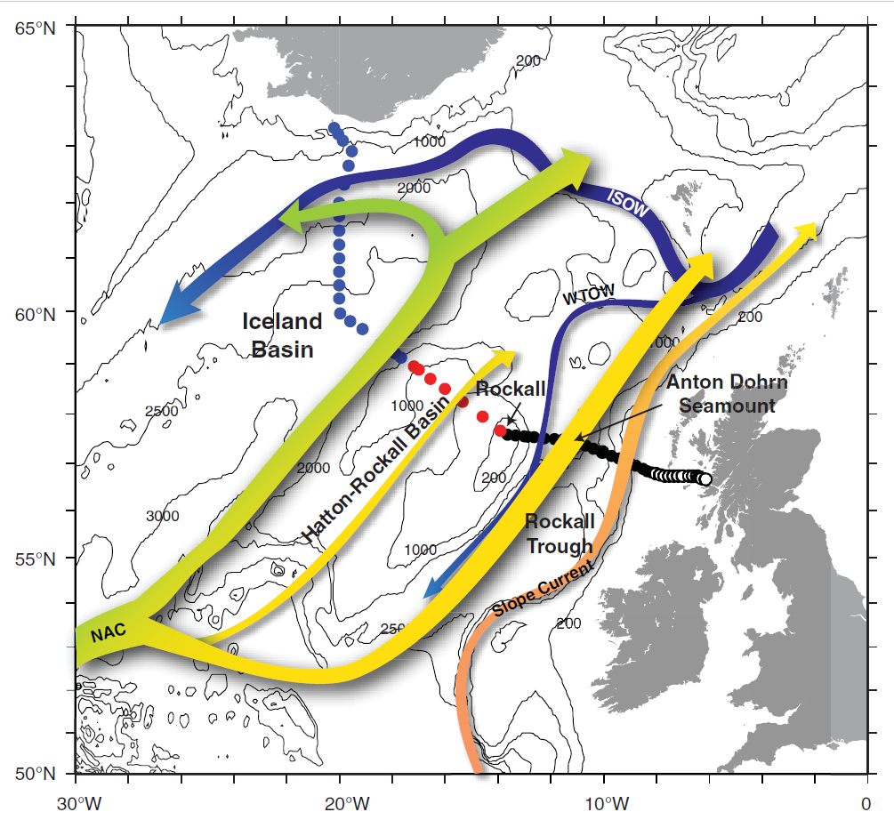
What Mattia already has
Format: CSV files
Extended Ellet Line includes data from 61 full depth stations at a horizontal resolution of 10-50 km for the period 1975-2017:
1975-1996: back and white dots nearly four times per year
1996-2017: blue, red, black and white dots at least yearly (annual averages available?)
Hydrography (T&S) and velocity from ADCP
Probably gridded data
Holliday et al. https://agupubs.onlinelibrary.wiley.com/doi/full/10.1002/2015JC010762

Slide 6
What Mattia already has
Format: netCDF file
Fair Isle-Munken section includes CTD data from ~17 stations sampled during ~150 cruises in the period 1981-2017:
Probably gridded data
YEAR | NUM. OF CRUISES
2010 | 5
2011 | 7
2012 | 8
2013 | 6
2014 | 8
2015 | 5
2016 | 5
2017 | 3
DATA @ https://data.marine.gov.scot/dataset/temperature-and-salinity-ctd-data-fair-isle-munken-section

Slide 7
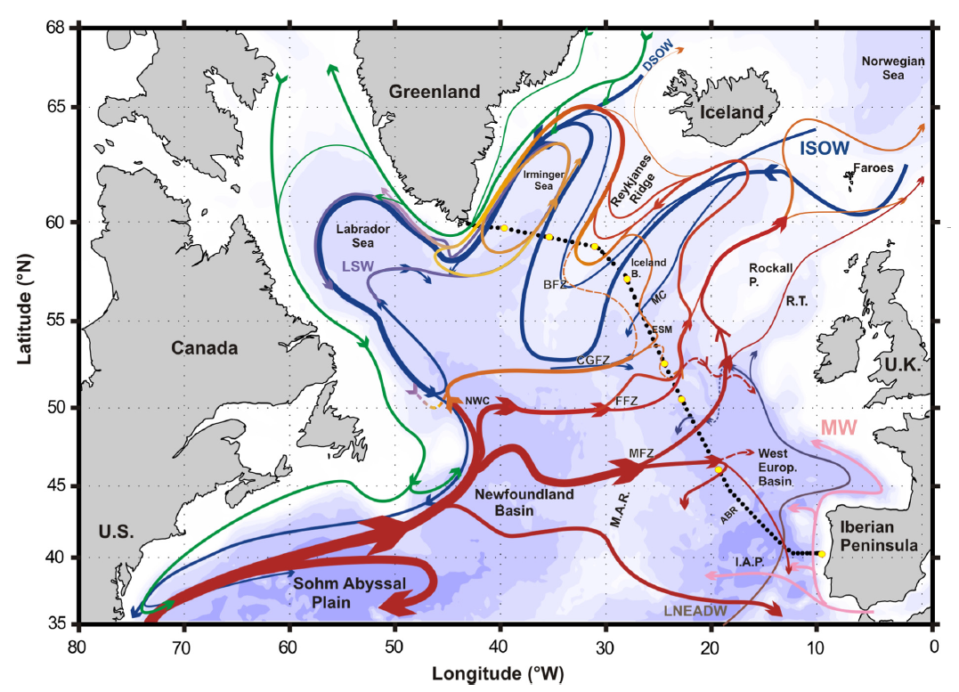
What Pierre already had
Format: netCDF file
Ovide section includes data from ~90 full depth stations at a horizontal resolution of 25-45 km sampled once a year for the period 2002-2012:
Hydrography (T&S) and velocity from ADCP
Gridded data
From Daniault et al. 2016

Slide 8
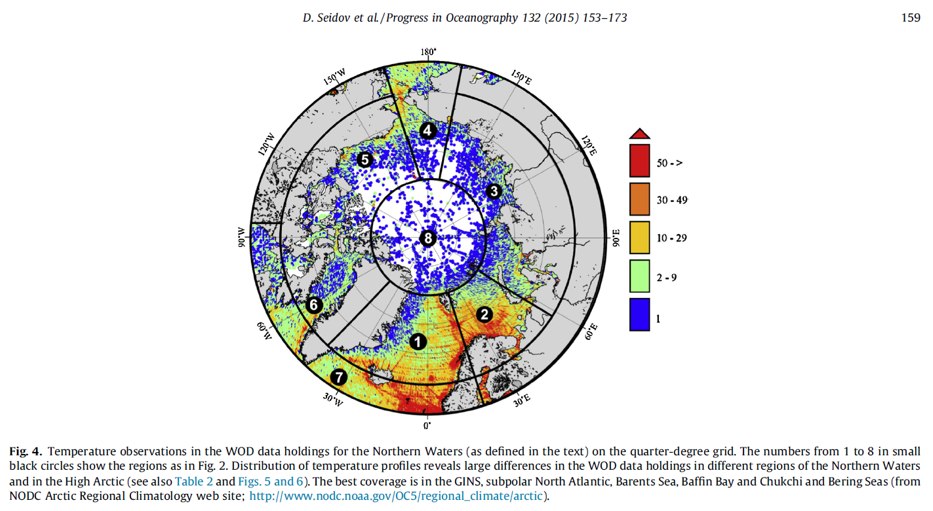
ARTIC OCEAN CLIMATOLOGY
Format: netCDF file
Data @ https://www.ncei.noaa.gov/products/arctic-regional-climatology

